Slide 1
Vaccine Equity Team 2
Sponsor: BU Spark!
Client: Dr. Julia Koehler
Member: Kush Vekeria, Liyu Qu, Jingyi Li, Zhou Ye

Slide 2
Goals and Background
Goals:
To understand the impact of grassroots organizations, like La Colaborativa, in the distribution of Covid-19 vaccinations of various age groups
To discover trends in vaccination rates amongst age groups with a particular focus on pediatric populations.
Background:
Access to quality healthcare and reputable information remains an issue for underserved communities in the State of Massachusetts
Our team’s primary focus was upon vaccinations by age group with emphasis on understanding the impact of efforts on pediatric vaccinations.
We have two data sets (Grouped.csv and Zipcode.csv) .

Slide 3
Data Collection
Grouped Dataset:
Split the whole dataset into 36 small dataset by age (0-19, 20-29, 30-49, 50-64, 65-75, 75+) and city (Chelsea, Revere, Springfield, Everett, Newton, Wellesley).
Used Interpolate method to fill empty data and keep the number of vaccination in an increasing trend
Zipcode Dataset:
Split the dataset by city (Wellesley, Chelsea, Revere, Springfield, Everett, Newton)
Used interpolation to fill empty values and maintain a linear trend.
Main Challenges:
Lots of NaN values results in missing data even after predictive measures (such as interpolation)

Slide 4
Main Analysis:
Fully Vaccinated Rate vs. Date
To see and compare the changes of the fully vaccinated rate in different cities
At Least One Dose Rate vs. Date
To see and compare the changes of the At Least One Dose rate in different cities
Notes:
Hypothesis test: We use hypothesis t test to test if the increase rate of vaccination in Chelsea is enough to be thought that we can reject null hypothesis and support that La Colaborativa has significant impact on vaccination (p<0.05).

Slide 5
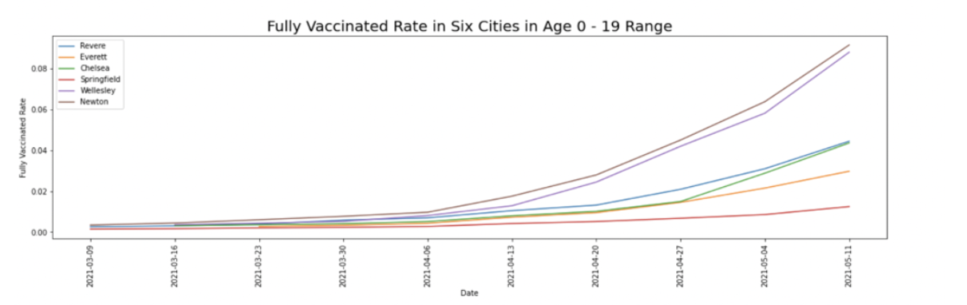
Fully Vaccinated Rate vs. Date
Notes:
We graphed the following fully vaccinated rate graphs for six age ranges (age 0-19, age 20-29, age 30-49, age 50-65, age 60-75, age 75+) and each line in the graphs corresponds to a city. The purpose is to figure out the characteristics and discrepancies of vaccination rate between different cities in each age range.
Because there are too many missing data for people aged 0-19, we cannot process the data to the complete timeline by any method.

Slide 6
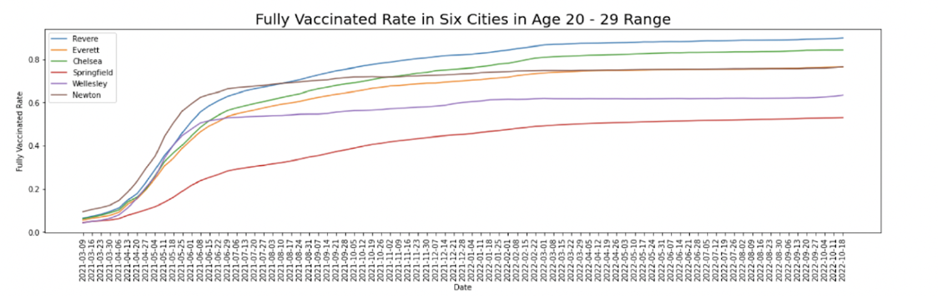
Fully Vaccinated Rate vs. Date
Notes:
By the graphs of fully vaccinated rate in age ranges 20-29, we can find that In the May and June of 2021, a large number of people were vaccinated.
Green line is Chelsea. Chelsea had a relatively high vaccination rate in the age group 20-29.

Slide 7
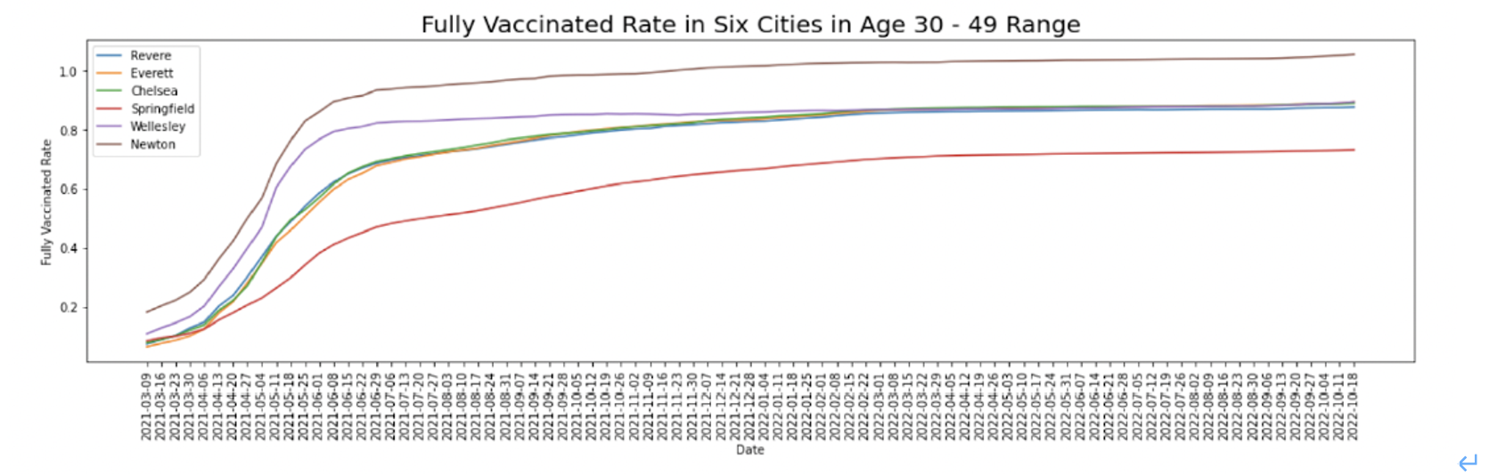
Fully Vaccinated Rate vs. Date
Notes:
For age range 30-49, the increase rate in all cities did not have a significant increase. Chelsea, Everett, Wellesley and Revere had the same fully vaccinated rate which was 80%.

Slide 8
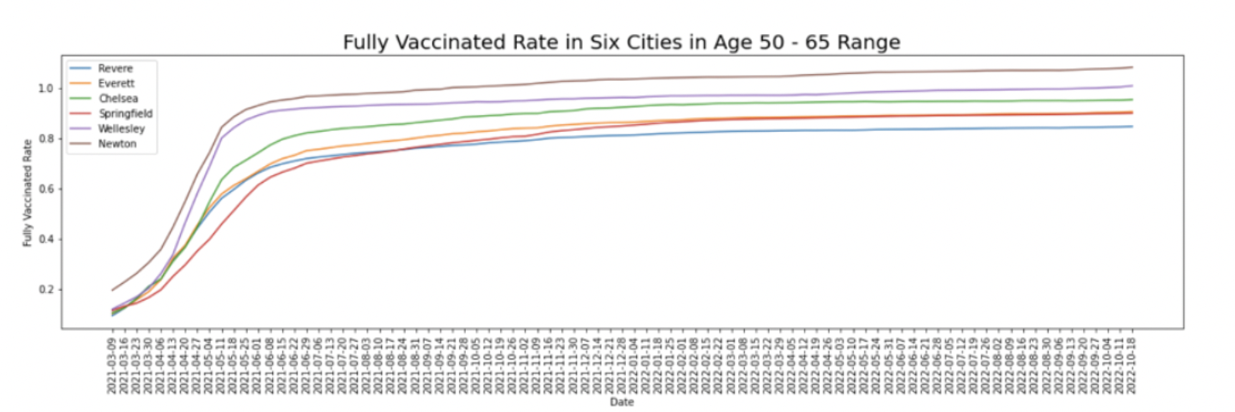
Fully Vaccinated Rate vs. Date
Notes:
People in the 50-65 age group received a large number of vaccinations from April 2021 to May 2021.

Slide 9
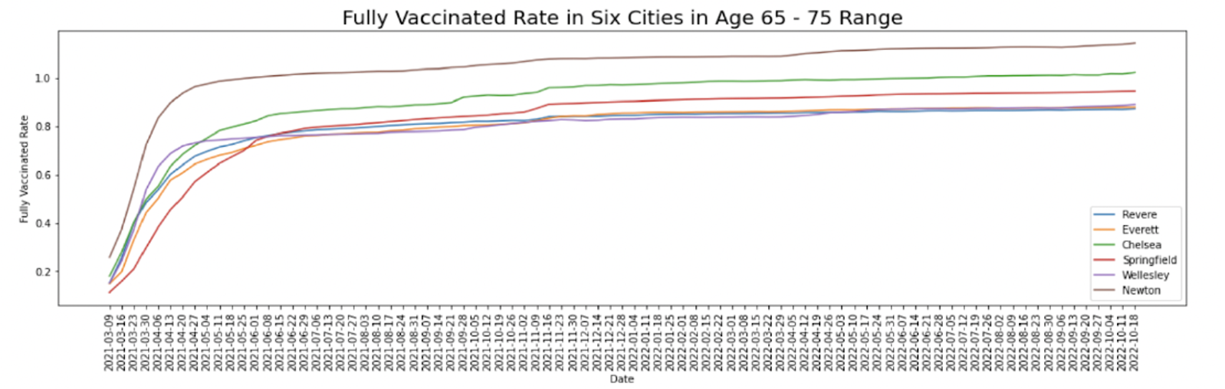
Fully Vaccinated Rate vs. Date
Notes:
People in the 65-75 and 75+ age groups received a large number of vaccinations from March 2021 to April 2021.
Compared to other five cities, Chelsea have higher rates of complete vaccination and growth rates in the 65-75 and 75+ age groups. （high growth rate because green line is more sloping compared to others)

Slide 10
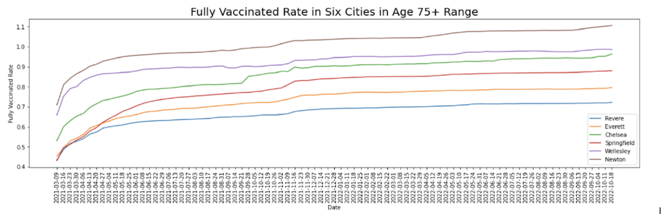
Fully Vaccinated Rate vs. Date

Slide 11
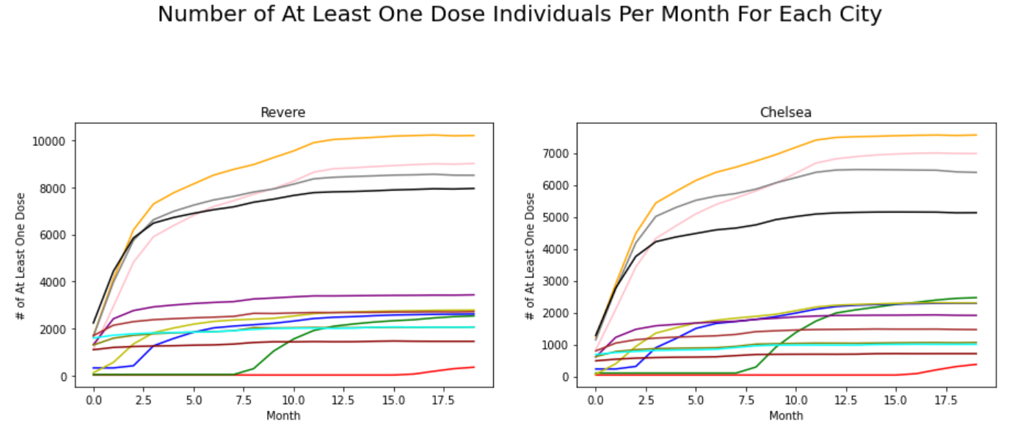

Slide 12
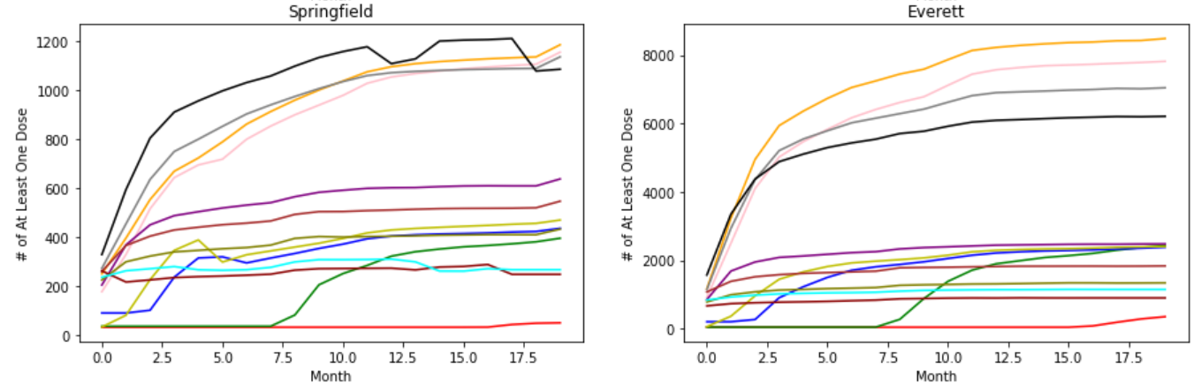

Slide 13
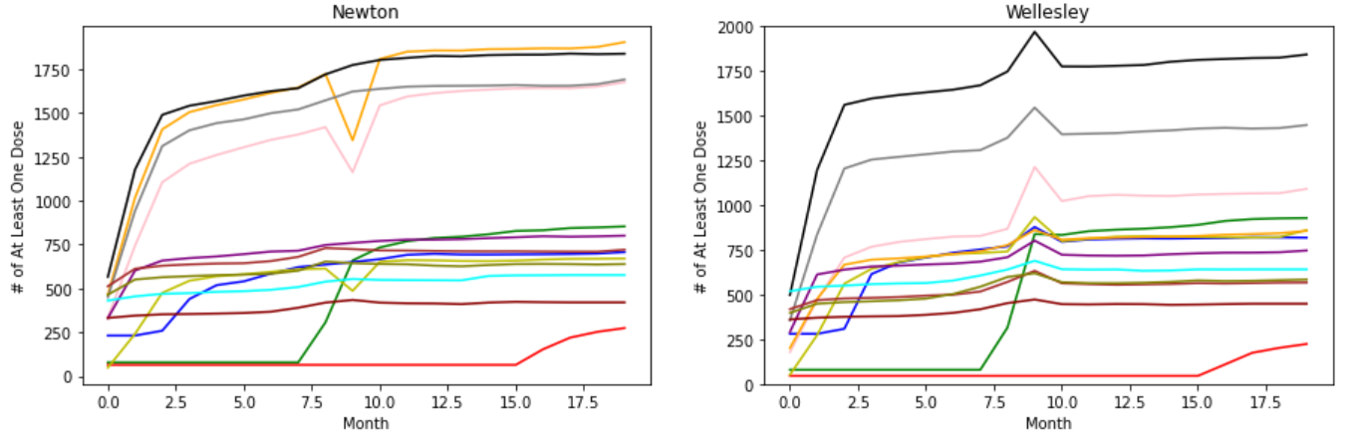

Slide 14
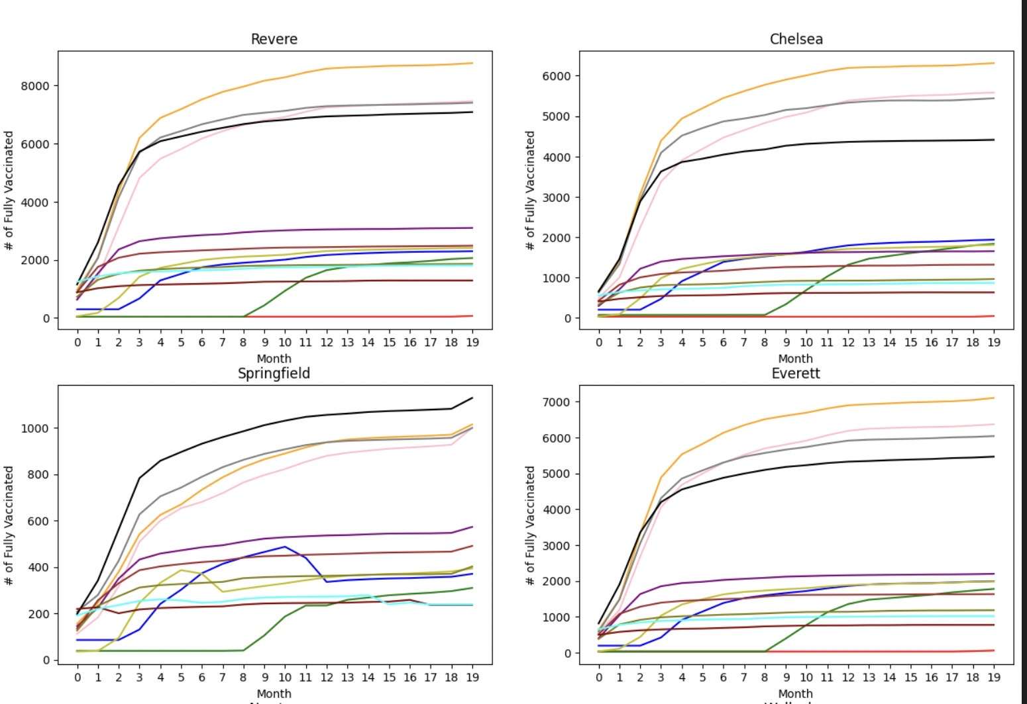

Slide 15
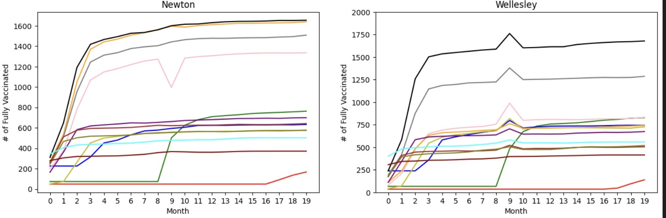

Slide 16
Conclusion
The vaccination rate of 50-75+ older people in Springfield is the highest among the six cities.
In the 65-75+ age group, Chelsea have higher rates of complete vaccination and growth rates than Revere.
Based on the average vaccination rate of each age group, Chelsea had a relatively high vaccination rate in the 20-29, 65-75 and 75+ age groups.

Slide 17
Next Step
Hypothesis Test
Regression Model
KNN Model
More Analysis

